Slide 1
Process Synchronization
Notes:
Video Module 4-01

Slide 2

Overview
Objectives
State, understand, and discuss the data-shared problem.
Introduce a solution to the data-shared problem: mutual exclusion.
Learn and understand process synchronization to implement mutual exclusion.
Learn and understand different tools to implement process synchronization.
Requirements
Review multithreaded processes

Slide 3
Data-Shared Problem
What is the data-shared problem?
Example

Slide 4
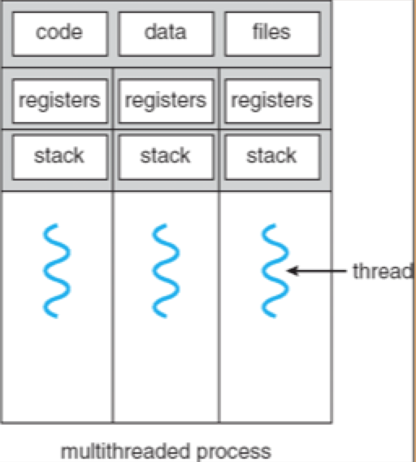
Data-Shared Problem Statement
When cooperating threads of execution access shared variables, the integrity of these variables may be violated if the access to data is not coordinated.
This definition raises some questions:
When do we get multiple/cooperating threads of executions?
interrupts
multithreaded process
How can variables be shared?
Look at multi threaded processes: the threads are sharing the data
With interrupts, data is within the same process
What does “coordinated” mean?
When one thread is accessing the shared data, the other thread should “wait the other thread to complete its access”.
What does “the integrity of these variables may be violated” mean?
these variables may take unintended/wrong values leading incorrect results.
See example in coming slidesl

Slide 5
Example : How Variable Integrity Can get Violated?
Consider two routines (threads)
Withdrawal ($60) from your account on an ATM
Monthly payroll deposit of $1,000 on your account
Oversimplification
Let B be your balance (shared variable)
Let Rg be a register of the CPU

Slide 6
Example (cont’d)
Payroll Thread
Load Rg,B Rg ←B
Add Rg, 1000 Rg ← Rg + 1000
Store B,Rg B ← Rg
ATM Withdrawal Thread
Load Rg,B Rg ←B
Sub Rg, 60 Rg ← Rg - 60
Store B,Rg B ← Rg

Slide 7
Example (cont’d)
B = $100
B = $1,100
B = $40
Sequential Execution
Load Rg,B
Sub Rg, 60
Store B,Rg
Interrupt ….
Load Rg,B
Add Rg, 1000
Store B, Rg
Interleaved Execution
Load Rg, B
Sub Rg, 60
Interrupt ….
Load Rg, B
Add Rg, 1000
Store B, Rg
Return from int..
Store B, Rg
Rg = $100
Rg = $40
Rg = $40 SAVED
Rg = $100
Rg = $1,100
B = $1,100
Rg = $40 RESTORED
B = $40
No problem!!!
Oops! Lost my salary

Slide 8
Problem Statement and Solution
When concurrent routines are cooperating and are accessing shared variables, the integrity of these variables may be violated if the access is not coordinated.
How to coordinate?
Solution: Mutual Exclusion through Process Synchronization

Slide 9
Process Synchronization
Mutual Exclusion
Notion of critical region (or section)
Notes:
Video Module 4-02

Slide 10
Mutual Exclusion
We must identify in each thread/process the segment of code which accesses shared variable(s).
Then, make sure that only one process is in its respective segment:
if one process is in its segment code, the other should not be in its own and vice versa ➔ Mutual Exclusion.
What is this segment code?
Answer: We call it the critical section, or the critical region.

Slide 11
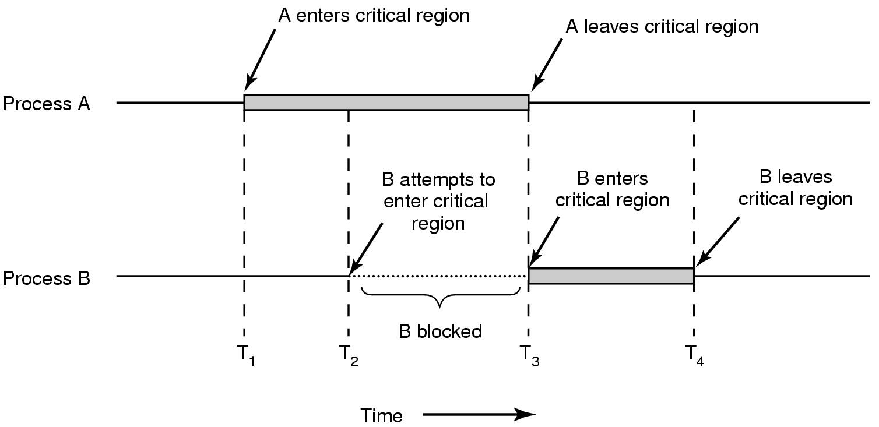
Critical Region
Accessing Shared Data
Accessing
Shared Data

Slide 12
Critical Region
Accessing Shared Data
Accessing
Shared Data

Slide 13
Examples of Critical Regions
Case: Payroll process and ATM Process
Payroll Process
Load Rg,B
Add Rg, 1000
Store B,Rg
ATM Withdrawal Process
Load Rg,B
Sub Rg, 60
Store B,Rg

Slide 14
Requirements for a Solution with Critical Regions
Mutual exclusion: No two processes simultaneously in critical region
Progress: No process running outside its critical region may block another process to enter its own critical region
Bounded waiting: No process must wait forever to enter its critical region
CPU speed independent: No assumptions made about speeds or numbers of CPUs
*Critical region is the same as critical section

Slide 15
Key Components of a Solution to Mutual Exclusion
Initialization: variables used to enforce mutual exclusion are intialized.
Entry: code which controls the entry to the critical section. Acts as a gate.
Exit : code used to inform the other process that a process left the critical section

Slide 16
User Level Solution (Two Threads)
Building a User Solution for Two Threads
Notes:
Video Module 4-03

Slide 17
A Typical Thread
while (1){
Entry to Region
Critical Region
Exit Region
Remainder
} /* end while (1) */

Slide 18
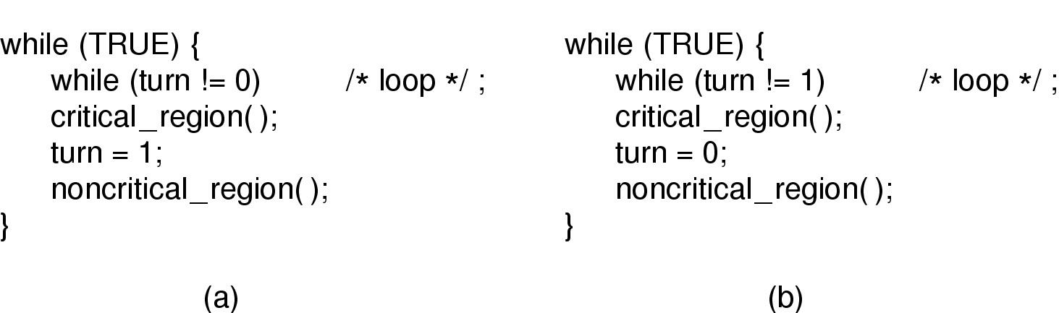
Mutual Exclusion with Busy Waiting (1)
Initialization: turn = 0
Entry
Exit
Mutual Exclusion ?
Yes
Progress ?
No!

Slide 19
Mutual Exclusion with Busy Waiting (2)
System variables: Interested[2] initialized as Interested[0] = Interested[1] = false
while (1){
while (1){
Interested[0] = true;
While (Interested[1]);
Interested[1] = true;
While (Interested[0]);
Critical Region
Critical Region
Interested[0] = false;
Interested[1] = false;
Remainder
Remainder
} /* end while (1) */
} /* end while (1) */
Mutual Exclusion ?
Yes
Progress ?
No
Notes:
Video Module 4-04

Slide 20
Peterson’s Solution (3)
System variables: Interested[2] initialized as Interested[0] = Interested[1] = false
while (1){
while (1){
Interested[0] = true; turn = 1;
While (Interested[1] && (turn == 1));
Interested[1] = true; turn = 0;
While (Interested[0] && (turn == 0));
Critical Region
Critical Region
Interested[0] = false;
Interested[1] = false;
Remainder
Remainder
} /* end while (1) */
} /* end while (1) */
Mutual Exclusion ?
Yes
Progress ?
Yes

Slide 21
Strategies/Tools for Mutual Exclusion
Strategies (Different Levels)
User Level
Hardware support
OS support
Languages constructs (monitors/conditional variables)
Notes:
Video Module 4-05

Slide 22
Strategies to Solve Mutual Exclusion
User level (algorithmic solution with no support from hardware or OS)
Two threads (covered)
Multiple threads (Baker algorithm)
Hardware support
Special instructions (Test-and-Set, Swap)
Disable interrupts
System Level:
OS services, language construct (monitors)

Slide 23
Baker Algorithm
Idea:
A process, when interested to get into the critical region picks a number (higher that all other processes who are already waiting to enter).
A process does not enter the critical region until all processes with smaller numbers leave the critical region.

Slide 24
Hardware Support (1)
Implementation of Test-And-Set Instruction
Test-and Set must be an atomic operation (either completely executed or not executed at all)
Boolean Test-and-Set(int *lock){
int register;
register = *lock;
lock = 1;
return(register = = 0);
}
Test-and-Set atomically:
Sets lock to 1
Tests whether the lock was open (0)

Slide 25
Mutual Exclusion Using Test-And-Set
System variables: Lock = 0;
while (1){
while (1){
While (!Test-And-Set(&Lock));
While (!Test-And-Set(&Lock));
Critical Region
Critical Region
Lock = 0;
Lock = 0;
Remainder
Remainder
} /* end while (1) */
} /* end while (1) */
Mutual Exclusion ?
Yes
Bounded Waiting ?
Yes
Progress ?
Yes

Slide 26
Hardware Support (2)
Implementation of Swap
Swap must be an atomic operation (either completely executed or not executed at all)
void Swap(int *lock, *key){
int register;
register = *lock;
*lock = *key;
*key = register;
}
Swap atomically Swaps the inputs

Slide 27
Mutual Exclusion Using Swap
System variables: ?
while (1){
while (1){
?
?
Critical Region
Critical Region
Remainder
Remainder
} /* end while (1) */
} /* end while (1) */
Mutual Exclusion ?
Bounded Waiting ?
Progress ?

Slide 28
Semaphores : An OS System Construct
A semaphore S is an integer variable which is accessed exclusively through two atomic operations
Down(S) (called also P primitive or wait)
Up(S) (called also V primitive or signal)

Slide 29
Semaphore (Cont’d)
Down (wait(S)) function (used as entry):
if (S <= 0)
sleep();
S = S – 1;
Up (signal(S))function (used as exit):
S = S + 1;
wake up some process
Mutexes are binary semaphores

Slide 30
Wrap Up
State, understand, and discuss the data-shared problem.
Introduce a solution to the data-shared problem: mutual exclusion.
Learn and understand process synchronization to implement mutual exclusion.
Learn and understand different tools to implement process synchronization
User level
two processes/threads (Peterson, busy waiting)
multiple processes/threads (Baker’s algorithm)
Hardware support (test-and-set, swap)
Language programming support (monitor, conditional variables)
OS support (semaphores, mutexes)
Notes:
Video Module 4-06

